Slide 1

Fake Currency Recognition
Team:
-> RITHIK V - 19MIS1189
-> Pondugala PRAVEEN – 20MIS1042
-> Kola Praneeth – 20MIS1151
-> Sudansh Rohan – 20MIS1163

Slide 2
-> ABSTRACT:
The main objective of this project is fake currency detection using the image processing. Fake currency detection is a process of finding the forgery currency. After choose the image apply pre-processing.
In pre-processing the image to be crop, smooth and adjust. Convert the image into grey colour. After conversion apply the image segmentation. The features are extracting and reduce.
Finally compare the image into original or forgery.

Slide 3
->OBJECTIVES:
The main objective of the project is to identify the fake Indian currency notes automatically using Morphological Algorithm.
Although there were many methods in existence, this method was designed to overcome the drawbacks of the previous methods. This method gives a faster and more accurate output when compared to the other techniques.
This system also calculates the total currency that we have given input.

Slide 4
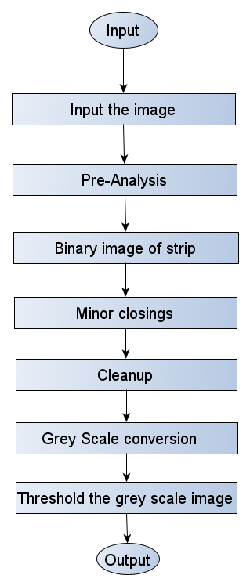
->Methodology:

Slide 5
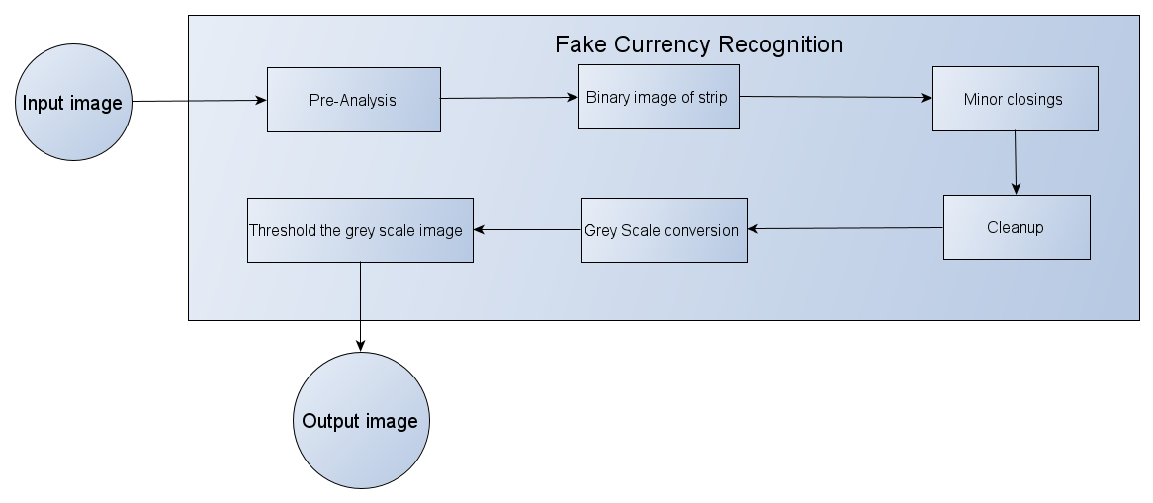
-> Architecture Diagram:

Slide 6
->Modules:
Image input:
Input the real image and the scanned image.
Pre-Analysis:
we will decompose image into HSV. The input image is which is in RGB is now converted to HSV image. Means both the real and scanned image will displayed in Hue, Saturation, Value.
Binary image of strip:
we will threshold the saturation and value planes so that we will get the combined saturation and the high and low values will become part of black strip. Now we will get a cropped image that will gives us black strip.

Slide 7
->Modules:
Grey Scale conversion:
The input image is converted into RGB to GREY scale.
Contrast enhance the gray image to emphasize dark lines in lighter background.
Remove the dark line.
Convert closed image to grey scale.
Take the difference between the closed grey scale and enhanced grey scale to find the
image projection.
Smooth the projection
Threshold the projection
Get the number of segments

Slide 8
-> Requirements:
Software Requirements:
- Programming Language: MATLAB
- Tool: MATLAB
- Operating System: Windows
Hardware Requirements:
- A computer with all the basic features (Eg: Monitor, Keyboard, Mouse, Disk Space of 1GB, RAM of 2GB)

Slide 9
->Results:
1. Pre-Analysis for original image

Slide 10
->Results:
2. Pre-Analysis for scanned image

Slide 11
->Results:
3. Binary image of strip:

Slide 12
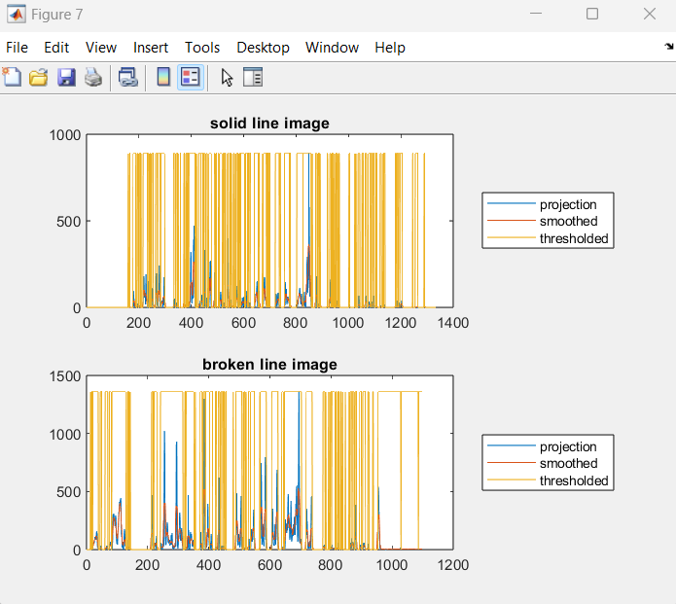
->Results:
5. Graph:

Slide 13
->Results:
6. Grey Scale conversion:

Slide 14
-> References:
A. S and D. M. Sasikumar, "Fake Currency Detection," 2019 International Conference on Recent Advances in Energy-efficient Computing and Communication (ICRAECC), 2019, pp. 1-4, doi: 10.1109/ICRAECC43874.2019.8994968.
Ankush Singh , Ankur Pandey , Aman Tekriwal , Prashant Mankani, Prof. Ketaki Bhoyar, 2019, Detection of Fake Currency using Image Processing, INTERNATIONAL JOURNAL OF ENGINEERING RESEARCH & TECHNOLOGY (IJERT) Volume 08, Issue 12 (December 2019).
Gouri Sanjay Tele et al.” Detection of Fake Indian Currency” in International Journal of Advance Research, Ideas and Innovations in Technology, Volume 4, Issue 2, 2018.

